Slide 1
Discipleship in a Gender-Confused Culture
Sex and gender, marriage and family, children and the Bible – in a time like this
Resources from Norway
● 50 PowerPoint slides ready for use
● Extensive background notes to many of the slides
● Eight 1-page resource sheets with discussion questions
● Free, comprehensive, totally flexible, no restrictions
www.MorFarBarn.no, in the menu Resources in English

Slide 2
Choose and pick freely
and without any restrictions from these 50 Power Point Slides
All the material we present here
(and everything on our website: www.MorFarBarn.no → Resources in English)
is a gift to you and anyone who wishes to make use of it, with no strings attached. The resources are totally free, super-flexible and defined by us as
materials in public domain.
You are totally free to make all the changes and adjustments that you prefer: Add slides, delete slides, integrate any slides into your own presentations,
change texts, illustrations, lay-out, etc., etc.
Use all or any of our material as if it were your own product. You need no permission to do whatever you find useful.
With love from Norwegian brothers and sisters in Christ Jesus!
post@morfarbarn.no

Slide 3
Some crucial questions
Are the world and mankind created? Is there a Creator who holds us responsible? – Or do we live in a universe without a Creator or God?
Is marriage God’s design for one man and one woman? – Or is marriage a ‘social construct’, a man-made invention, which we are free to define and redefine as we like?
Is it a God-given right for children to know their father and mother? – Or is planned fatherlessness or mother- lessness in a child’s life in accordance with God’s will?
Are homosexual relationships in harmony with God’s will? – Or does the Bible teach that sexual relationships belong within a marriage between a man and a woman?
Is biological sex and gender defined on the basis of feelings and preferences, or on biology? How many bio-logical sexes are there? What about XX and XY chromosomes?

Slide 4
The LGBT+ and Pride Agenda: A Revolution
Part 2 of the sexual revolution
A child and youth revolution
A family revolution
A cultural revolution
A worldview revolution
A paradigm shift
A spiritual battle

Slide 5
Basic Truths
The radical gender-neutral ideology challenges fundamental truths about gender, sexuality, children, marriage and so on.
The concept of biological sex and gender
The significance of man and woman, mother and father, and
the complementarity of the two sexes
The purpose and framework of sexuality
Procreation and parenthood
The uniqueness of the mother-father-child relationship
The child’s right to know his or her biological roots
Laws concerning the family
The significance of relatives and biological relations
The definition, meaning and characteristics of marriage

Slide 6
Where the battle rages
‘If I profess with the loudest voice and clearest exposition every portion of the Word of God except precisely that little point which the world and the devil are at that moment attacking, I am not confessing Christ, however boldly I may be professing Him.
Where the battle rages, there the loyalty of the soldier is proved.
To be steady on all the other battle fronts is mere flight and disgrace if he flinches at that point.’
Martin Luther

Slide 7
Which strategy?
Capitulation?
Compromise?
Confrontation?
Christ?

Slide 8
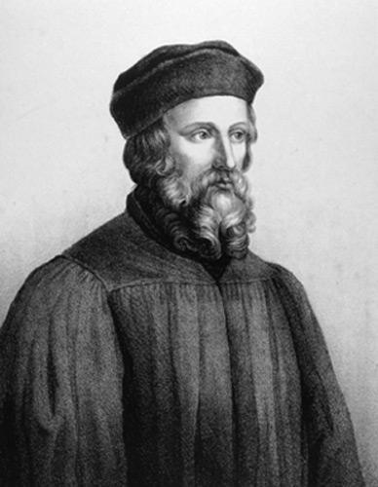
Live the truth ‘Therefore, faithful Christians, seek the truth, listen to the truth, learn the truth, love the truth, speak the truth, keep the truth, defend the truth until death; for the truth will set you free from sin, from the devil, from death of the soul, and finally, from eternal death, which is the eternal separation from God’s mercy.
My dearest, live according to the discerned truth which prevails over everything and is powerful forever.’
Jan Hus, Czech reformer, 1369–1415

Slide 9
Jesus said:
‘If you hold to my teaching, you are really my disciples. Then you will know the truth, and the truth will set you free.’
John 8:31–32 (NIV)

Slide 10
A central message from Postmodernism
and Pride ideology Not:
‘The truth will set you free.’
But:
Freedom will make you true! = «Boundless, unlimited freedom will make you find your true self.»

Slide 11
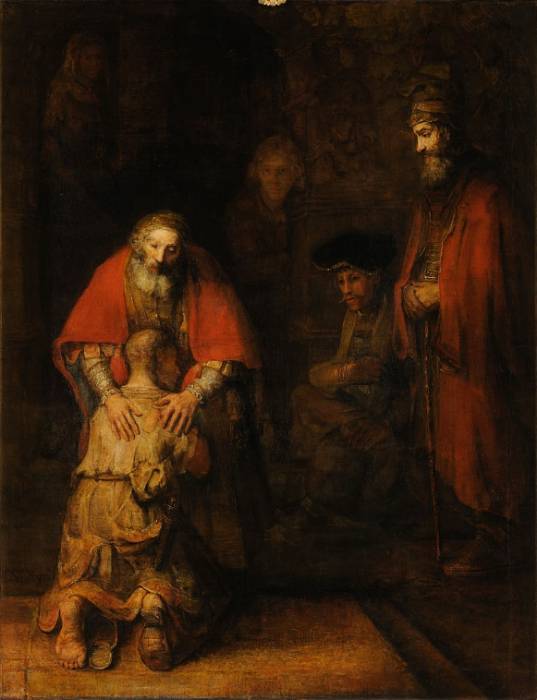
The example and teaching of Jesus
CREATED AND LOVED BY GOD
Everyone is created by God, loved by Him and has the same worth as all other human beings.
LOVING MY NEIGHBOUR As Christians we are called to meet everyone with the love of Jesus – in words, attitudes and actions.
GRACE and TRUTH
Both are necessary and biblical – not only grace, or only truth. They are like two wings, two oars, or train tracks. Both grace and truth are important and indispensable.

Slide 12
Motivation and resources
$■$Love
$■$ Calling
$■$ Consequences
$■$ Knowledge
$■$ Battle
$■$ Power
$■$Love

Slide 13
3 Truths we have to defend
$■$The hetero norm
Man & woman / father & mother
The mother-father-child
relationship is unique.
$■$ The gender norm
There are only two biological sexes. Gender identities based on subjective feelings are not new sexes.
$■$ The couple norm
Marriage and sexual relations are for two people. Polyamorous relationships are not a Christian option.

Slide 14
The message
of the radical gender-neutral ideology 1) A fundamental premise: all sexual orientations, all gender identities and all gender expressions are equally valid and valuable ‘variants of normality’: hetero, homo, bi, poly, pan, trans and so on. – everything is considered equally natural, normal and ethically acceptable.
2) The significance of gender, of man and woman, of mother and father is negated. The difference between norm/ideal and exception is abolished and made irrelevant.
3) All kinds of sexuality, all kinds of sexual acts and all kinds of relationships are considered positive, as long as they are voluntary and without pressure and abuse. The ideal and goal is unlimited diversity and freedom without boundaries.
4) The focus is on adults and their demands and wishes.

Slide 15
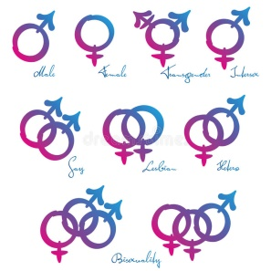
71 gender identities for users of Facebook in England
Agender
Androgyne
Androgynes
Androgynous
Asexual
Bigender
Cis
Cis Female
Cis Male
Cis Man
Cis Woman
Cisgender
Cisgender Female
Cisgender Male
Cisgender Man
Cisgender Woman
Female to Male
Female to male trans man
Female to male transgender man
Female to male transsexual man
F2M
FTM
Gender Fluid
Gender neutral
Gender Nonconforming
Gender Questioning
Gender Variant
Genderqueer
Hermaphrodite
Intersex
Intersex man
Intersex person
Intersex woman
Male to Female
Male to female trans woman
Male to female transgender woman
Male to female
transsexual woman
Man
M2F
MTF
Neither
Neutrois
Non-binary
Other
Pangender
Polygender
T* man
T* woman
Trans
Trans Female
Trans Male
Trans Man
Trans Person
Trans*Female
Trans*Male
Trans*Man
Trans*Person
Trans*Woman
Transsexual
Transsexual Female
Transsexual Male
Transsexual Man
Transsexual Person
Transsexual Woman
Transgender Female
Transgender Person
Transmasculine
Two* person
Two-spirit
Two-spirit person
Woman

Slide 16
The radical gender-neutral ideology:
A head-on collision
The radical gender ideology is a serious challenge for Christians. The ideology is in conflict with fundamental truths in Christian theology, teachings and ethics about human life.
1. Biological sex
2. Gender
3. Sexuality
4. Parenthood
5. Children
6. Marriage
7. Family

Slide 17
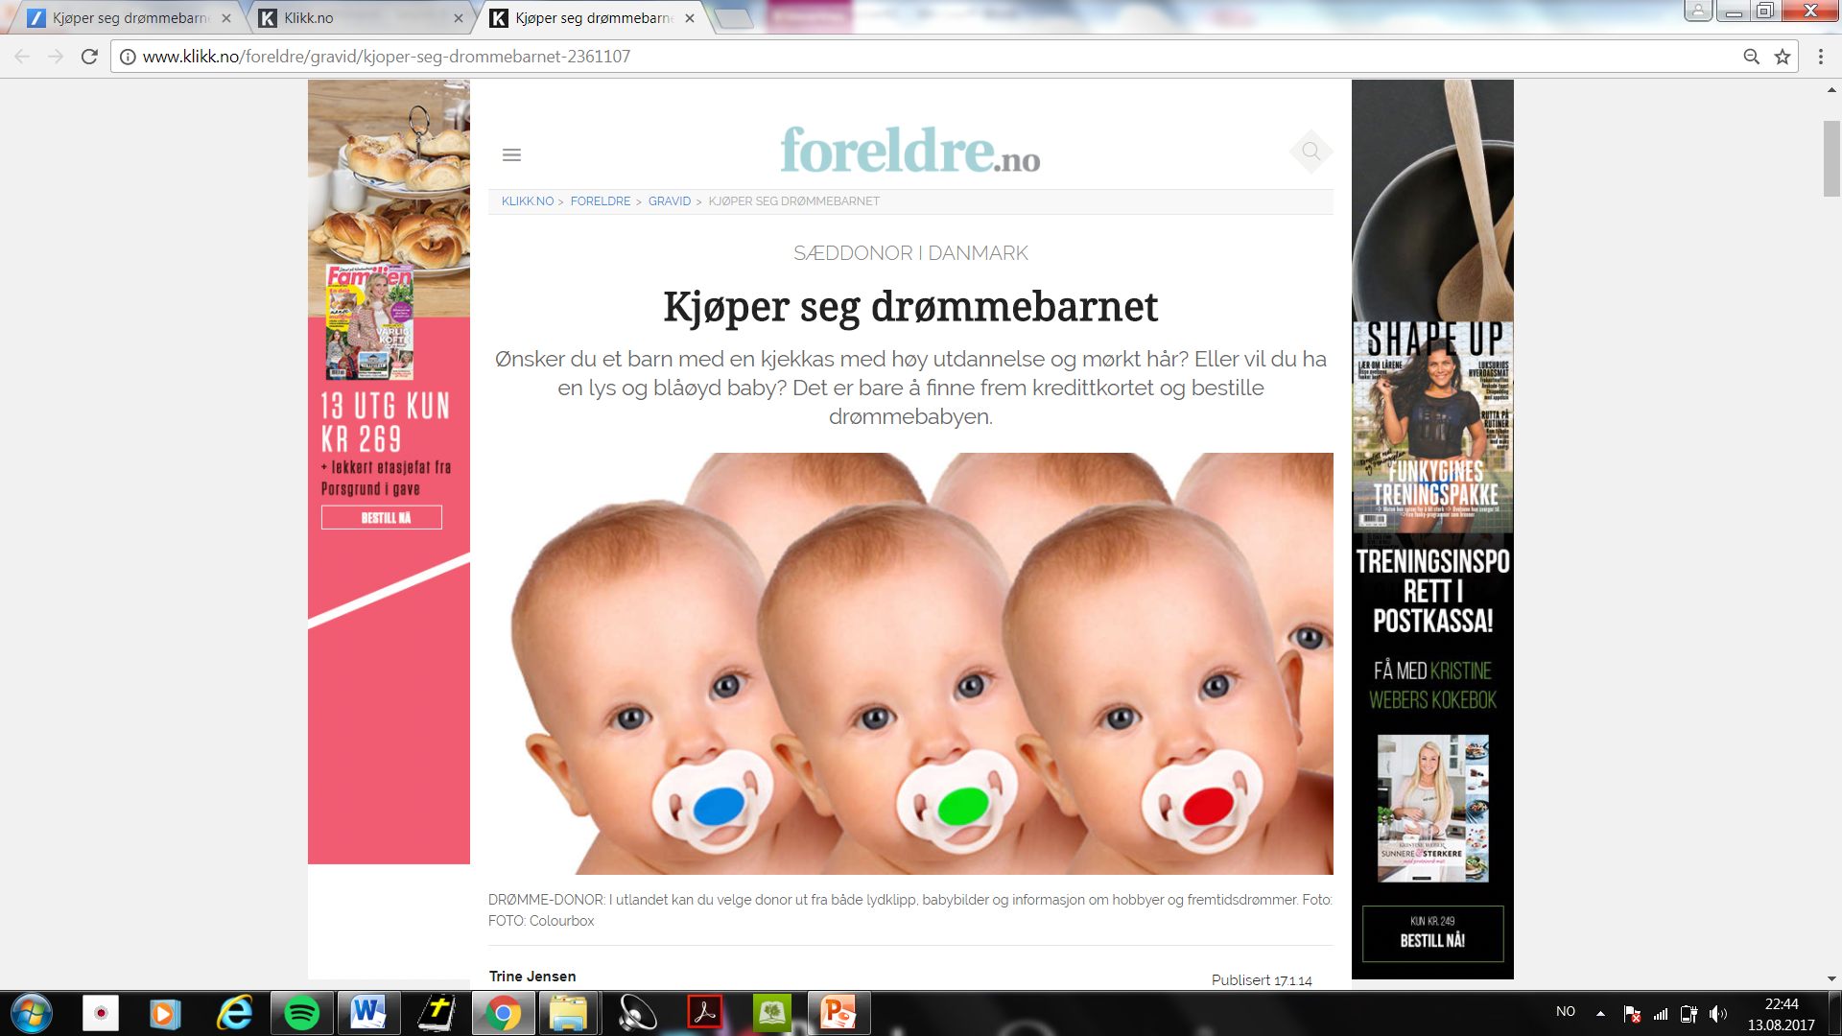
A new understanding of children and parenthood:
‘Get out your credit card and order your dream baby’
See English translation and comments in the area for notes below.
Notes:
This slide – which is a copy from a Norwegian website called foreldre.no (meaning «parents.no» in English) shows in a dramatic way how many people’s view regarding conception, children and parenthood is undergoing a radical change in our days. The message stands in sharp contrast to the biblical theology of conception, parenthood, family and children’s rights to both their mother and father.
The introduction to the article reads: «Do you want a child with a cool donor who has higher education and dark hair? Or would you prefer a blond and blue-eyed baby? Just get out your credit card and order your dream baby.» The rest of the article tells Norwegian women how to about in order to contact a fertility clinic in Denmark and buy insemination with semen from a donor.
This example may seem far-fetched for many people, but it is in fact a reality that thousands of women in many countries make use of each year. The fertility industry is a big billion dollar business.
Even many top politicans endorse this business. Here is a translated quotation from a book written in 2017 by a well-known Norwegian politician (together we a former leader of the biggest LGBT organisation in Norway). The book has the title «Homo», with the following sub-title: «For you who are, wondering if you are or want to become homo». This politician has lately been part of the Norwegian government.
Yes, you can have children
There is a multitude of websites and fertility clinics which sell semen. They offer varied information about the person you are buying from. In most cases you get to know height, education, colour of hair and eyes, and also the health profile of the donor you choose. Other clinics give you more information. You can buy childhood and adult pictures of the donor, soundtracks of his voice, video interviews, supplementary profile with personality tests and the impression that the donor has made on the staff of the clinic. You can shop the characteristics you want, dependent on what you are willing to pay.» (page 223)
The quotation in the original Norwegian text:
Joda, du kan få barn «Det finnes et mylder av nettsider og banker som selger sæd. De gir ulik informasjon om hvem du kjøper fra. I de fleste tilfeller får du vite høyde, utdannelse, hår- og øyefarge samt helseprofil på donoren du velger. Andre klinikker gir deg mer informasjon. Du kan kjøpe barnebilder, voksenbilder, lydfil av stemmen, videointervju, utfyllende profil med personlighetstester og inntrykket den aktuelle donoren har gitt personalet ved klinikken. Du kan shoppe de egenskapene du vil, avhengig av hva du er villig til å betale.» (side 223)
MOMENTER til taleren
Advarsler som for få år siden ble avvist som spekulativ skremselspropaganda, skjer nå rett for øynene på oss. Det internasjonale barnemarkedet er big business med en omsetning på milliarder av kroner.
Det som for 10-15 år siden ble ansett som et urealistisk science fiction-scenario, som lovgiverne og befolkningen aldri ville godta, er nå blitt mer og mer stuerent. Det skjebnesvangre skiftet i Norge fant sted da Stortingets vedtok at ekteskapet er kjønnsnøytralt, og at også likekjønnede par har rett til å få barn med statens hjelp. Barn ble en rettighet. Ettersom likekjønnede par ikke kan få felles barn, ble det nødvendig å godta at barnemarkedets tjenester er nødvendige og nyttige – både for likekjønnede par, men også for single kvinner og andre som ønsker seg barn.
Tragisk nok synes stadig flere nordmenn synes at dette er en helt naturlig og moralsk høyverdig måte å få barn på. Det er et godt eksempel på hvor lett folk venner seg til noe som for få år siden var sett på som uetisk og fullstendig uakseptabelt. Når politikerne og lovverket har åpnet døren, er det få grenser for hva som vil skje i fortsettelsen.
Et viktig spørsmål: Hva vil kristne mennesker og menigheter gjøre i møte med denne utviklingen? Vil vi også tilpasse oss og venne oss til at barn er en rettighet og en handelsvare, eller vil vi holde fast på at Gud er Skaperen, og at barnemarkedet frontkolliderer med Bibelens verdier og etikk? Har vi mot og styrke til å være en motkultur?

Slide 18
Challenging for children
■ Ethical relativism: ‘If you want it, do it!’ One rule: Mutual consent.
■ Gender as fluid/elastic: Who am I, really?
■ Very few boundaries, ideals, expectations, norms. Limitless freedom.
■ Result: confusion, uncertainty, experimentation. Demanding
challenges emotionally, spiritually, mentally and physically.
■ Young people in puberty: They are vulnerable at many levels. Turbulent phase of life. Family and church become more important than ever.
■ Happier? Will people become more harmonious, have less relational problems, more stable marriages, more stable societies?
■ It may cost more and more – also for young people – to stand up for biblical truths in an age where feelings, limitless individualism and relativism dominate + a gender-neutral ideology tries to negate biological realities.

Slide 19
Changing one’s legal gender An example from Norway
1. June 2016: ‘Law concerning change of legal gender’ was approved. Applicable to everybody. A person can change as many times as he or she want after the age of sixteen.
2. No counselling is needed, no medical diagnosis, no treatment of any kind.
3. Children as young as six can change
legal gender if both parents agree.
4. Same rights and obligations as other
people with the same legal gender. Woman in a man’s body, man in a
woman’s body. A trans man (a man defined by law as a man, in a woman’s body) may be able to give birth to children.

Slide 20
3 important driving forces
1. Extreme individualism
2. Radical ethical relativism
3. Different forms of atheism

Slide 21
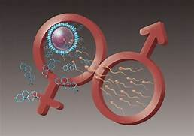
Three reasons for defending biblical marriage
■ Biology Only one man and one woman together can have a baby. The mother-father-child relationship is unique and essentially different from every other relationship.
■ Babies According to the UN Convention on the Rights of the Child (Article 7.1), every child has ‘the right to know and be cared for by his or her parents’. Children have a natural and God-given right to their own parents. Neither mother nor father is superfluous.
■ Bible The entire Bible is very clear that marriage between a man and a woman and the mother-father-child relationship are two of God’s most foundational institutions.

Slide 22
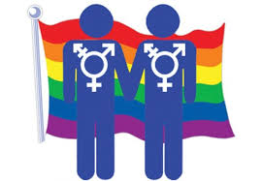
Three (Four?) stages in the gender and family battle
in many Western countries
ACCEPTANCE : ca 1950 – ca 1990
EQUAL STATUS: ca 1990 – ca 2010
DOMINANCE: ca 2010 →
CRIMINALIZATION of resistance to the LGBT agenda in some countries?

Slide 23
What is
TOLERANCE?
False conception of tolerance: ‘You are tolerant only if you agree that my opinion or conviction is as good, acceptable and true as yours!’ [= Relativism]
True tolerance: ‘I wholeheartedly disagree with you, but nevertheless I will
sincerely respect and defend your right to have and to express your convictions and views.’
(And you can add: ‘I hope you’ll do the same! Tolerance cannot be a one-way street.’)

Slide 24
Two lies about tolerance
The well-known pastor Rick Warren is the author of the best-seller The Purpose Driven Life. He says:
‘Our culture has accepted two huge lies.
The first lie is this: If you disagree with someone’s lifestyle,
it’s because you fear or hate them.
The second lie is this:
To love someone means that you agree with everything they believe or do.
Both are nonsense.
You don’t have to compromise your convictions to be compassionate.’

Slide 25
Four pillars in the biblical theology of the family
1. MARRIAGE Marriage is God’s design for man and woman, instituted by God Himself. It is not a human invention or a social construct.
2. The MOTHER-FATHER-CHILD relationship The mother-father-child relationship is unique. It is essentially different from all other relationships.
3. THE CHILD’S PERSPECTIVE Children have a God-given right to their own mother and father. Nobody has the authority to rob them of this right. Neither mother nor father is irrelevant or superfluous. Children are a gift, not a ‘right’ or a commodity on the fertility market.
4. TWO BIOLOGICAL SEXES There are only two biological genders, because there are only two types of reproductive cells: male and female. It is not possible to procreate in any other way. There are dozens of subjective gender identities based on feelings and preferences, but these are not new biological sexes.

Slide 26
The Bible is clear:
Marriage is created by God as an institution for a man and a woman.
A crystal clear message:
▪ The creation account in Genesis 1–3
▪ The Ten Commandments. (‘Honour your father and your mother …’)
▪ The life and teachings of Jesus
▪ All stories, examples and teachings throughout the Bible
▪ In the New Testament: Christ is the bridegroom, His people are the bride
▪ Neither the Old nor the New Testament suggest in any way that marriage can be something other than between a man and a woman. There is not a single exception in the entire Bible.

Slide 27
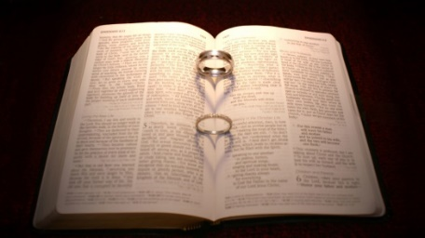
Two fundamental texts about marriage
Genesis 1:27–28 and 2:24 (NIV)
‘God created mankind in his own image, in the image of God he created them; male and female he created them.’
‘That is why a man leaves his father and mother and is united to his wife, and they become one flesh.’
Matthew 19:4–6 (NIV) ‘“Haven’t you read,” he [Jesus] replied, ‘that at the beginning the Creator “made them male and female,” and said,
“For this reason a man will leave his father and mother and be united to his wife, and the two will become one flesh”?
So they are no longer two, but one flesh. Therefore what God has joined together, let no one separate.’

Slide 28
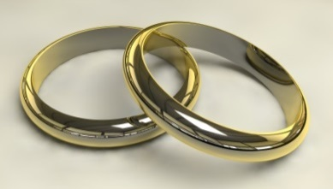
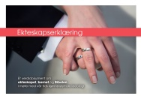
A biblical understanding of marriage
Genesis 2:24 • Matthew 19:5 • Mark 10:7–8 • Ephesians 5:31
The natural family, with biological parents
An adult, an independent person
Departure,
a new phase of life, new loyalty
That is why a man will leave
his father and mother and
be united to his wife,
and the two will become one flesh.’
Two sexes which belong to and complement each other
A new family, a new social unit, lifelong faithfulness
Process of love, learning and development
Unique physical, emotional and spiritual unity between man and woman → Family and parenthood
A couple, consisting of one man and one woman

Slide 29
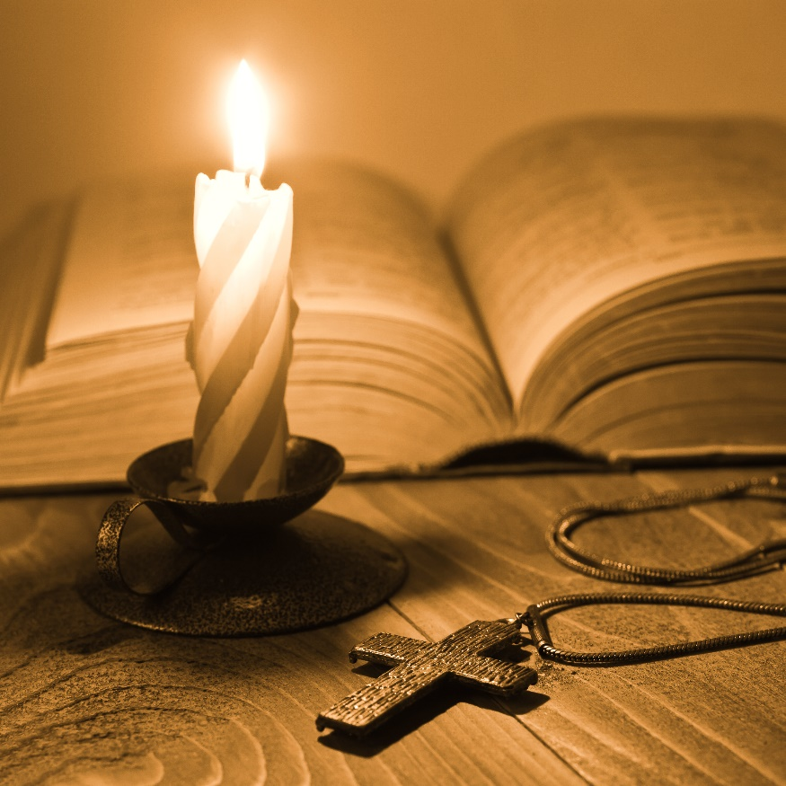
Changes in the theology of gender and sexual ethics are often a result of changes in other theological issues
• Doctrine of the authority of the Bible
• The authority of Jesus and the apostles
• Definition of the gospel
• Theology of sin and grace
• Repentance and salvation
• Doctrine of the church
• Creation theology

Slide 30
Two fundamental
truths to remember
WE ARE A DIFFERENT PEOPLE. We belong to another kingdom, another Lord, we have other values and priorities, and we obey another authority. We are ‘strangers’ and ‘foreigners’, see 1 Peter 1:1, 17b; 2:11. Jesus says in John 17 that His people are ‘in the world’, but not ‘of the world’ and He sends us ‘into the world’.
THE CENTRALITY OF TRUTH. - God’s truth never expires, is never out of date - God’s truth is never a lost cause - ‘Never, never, never ask: Is it possible/worthwhile? Ask only: Is it true?’ (Kaj Munk) Jesus said, ‘I am the way, the truth and the life’ (John 14:6). Jan Hus: «Live the truth!» (See his text in another slide)

Slide 31
Commandments
and love
God’s commandments are given in love
They are expressions of His love for us. To construct a conflict between ‘love’ and God’s commandments is unbiblical and untenable. Jesus, for instance, says: ‘If you keep my commands, you will remain in my love, just as I have kept my Father’s commands and remain in his love’ (John 15:10).
The apostle John writes: ‘This is how we know that we love the children of God: by loving God and carrying out his commands. In fact, this is love for God: to keep his commands. And his commands are not burdensome’ (1 John 5:2–3).

Slide 32
Four different words for ‘LOVE’
in Greek, the language of the New Testament
Agape – God’s undeserved love
Filia – Deep friendships and suchlike
Storge – Love between family members
Eros – Romantic and erotic love
● In the New Testament, the word agape is most used.
● 1 John 4:8: «God is love/agape», not: «God is eros.»
● 1 Corinthians 13:13: «Now these three remain: faith, hope and agape. But the greatest of these is agape.»

Slide 33
How are we to face the radical
gender-neutral ideology?
• PROCLAIM A CLEAR YES to God’s design for family, marriage and children. His will and creation mandate are good for individuals, for children and for society.
• BE ‘FAITHFUL TO THE TRUTH IN LOVE’ (Ephesians 4:15) – with Jesus as our model. Expose and uncover ideologies, values, philosophies and moral norms which are in conflict with God’s Word and His will, while at the same time showing love towards our neigbours and our adversaries. We must distinguish clearly between individuals and ideologies.
• SHOW THAT RADICAL GENDER-NEUTRAL IDEOLOGY IS UNTRUE. It is not true that gender, children and parenthood don’t belong together. Male and female sex is not a social construct independent of biology.
• TACKLING THE RADICAL GENDER-NEUTRAL IDEOLOGY IN PRAYER. Whether we like or not, we are part of a cultural and spiritual battle. It must be fought also in prayer – not against people, but against unbiblical ideologies. – ‘Ora et labora!’
• A REGULAR DIALOGUE WITH OUR CHILDREN AND YOUNG PEOPLE about the biblical understanding of sex and gender, sexuality, marriage and family.
• BE WILLING TO PAY THE COST OF DISCIPLESHIP. We have to accept and get used to the fact that our faith in Jesus as Lord and Master will come at a price, in accordance with what He taught His followers.

Slide 34
Communicating the truth:
A positive message regarding fundamental values
YES to the Bible as our authority for faith, doctrine and life
YES to marriage as God’s design for one man and one woman
YES to the uniqueness and significance of the mother-father-child relationship
YES to children’s God-given right to know their own mother and father
YES to the perspective of the child in the theology and practice of the Christian church
We are not called to win discussions, but to witness about what we believe, in whom we believe, and why we believe

Slide 35
A few selected websites on sex, gender, sexuality and marriage
The Center for Faith, Sexuality & Gender – www.centerforfaith.com
www.TheGospelCoalition.org – A escellent website with lots of topics. Search words like ‘same-sex marriage’, ‘transgender’, ‘gender’, ‘marriage’ etc.
www.robGagnon.net – A very useful blog with numerous valuable articles on topics related to the Bible and homosexuality, same-sex marriage, transgenderism, etc. by a conservative theology professor.
www.ThePublicDiscourse.com – An excellent website. Search words like ‘same-sex marriage’, ‘transgender’, ‘gender’, ‘marriage’ etc.
List of some good books, a few in Norwegian but mostly in English: www.Samlivsbanken.no/gode-boker. See also www.Christianbook.com
www.LivingOut.org – Christian and gay. Excellent website.
www.TransgenderTrend.com – Numerous useful resources.
www.GenSpect.org – A voice for parents with gender-questioning kids.
For a list of useful websites on transgender topics in English: www.transinfo.no/tema/nyttige-nettsteder
www.FamilyLogo.org – An alternative rainbow logo with different messages.

Slide 36
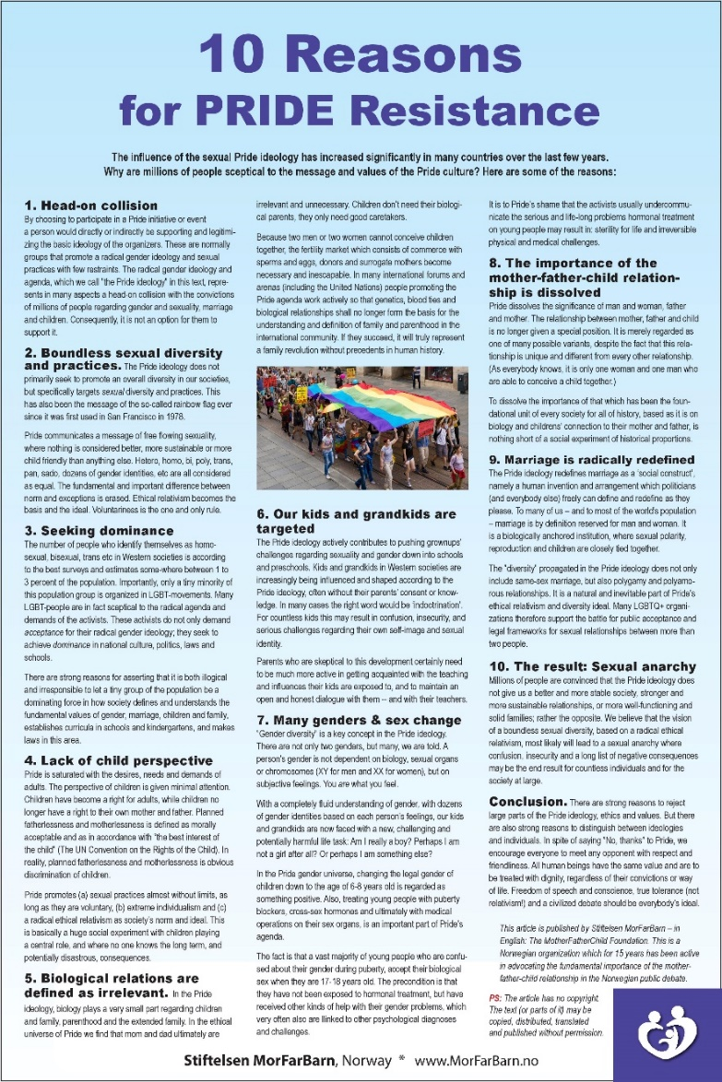
Download this resource sheet and use the text (or parts of it) in any format you like:
https://morfarbarn.no/file/10-reasons-for-pride-resistance-2020.pdf

Slide 37
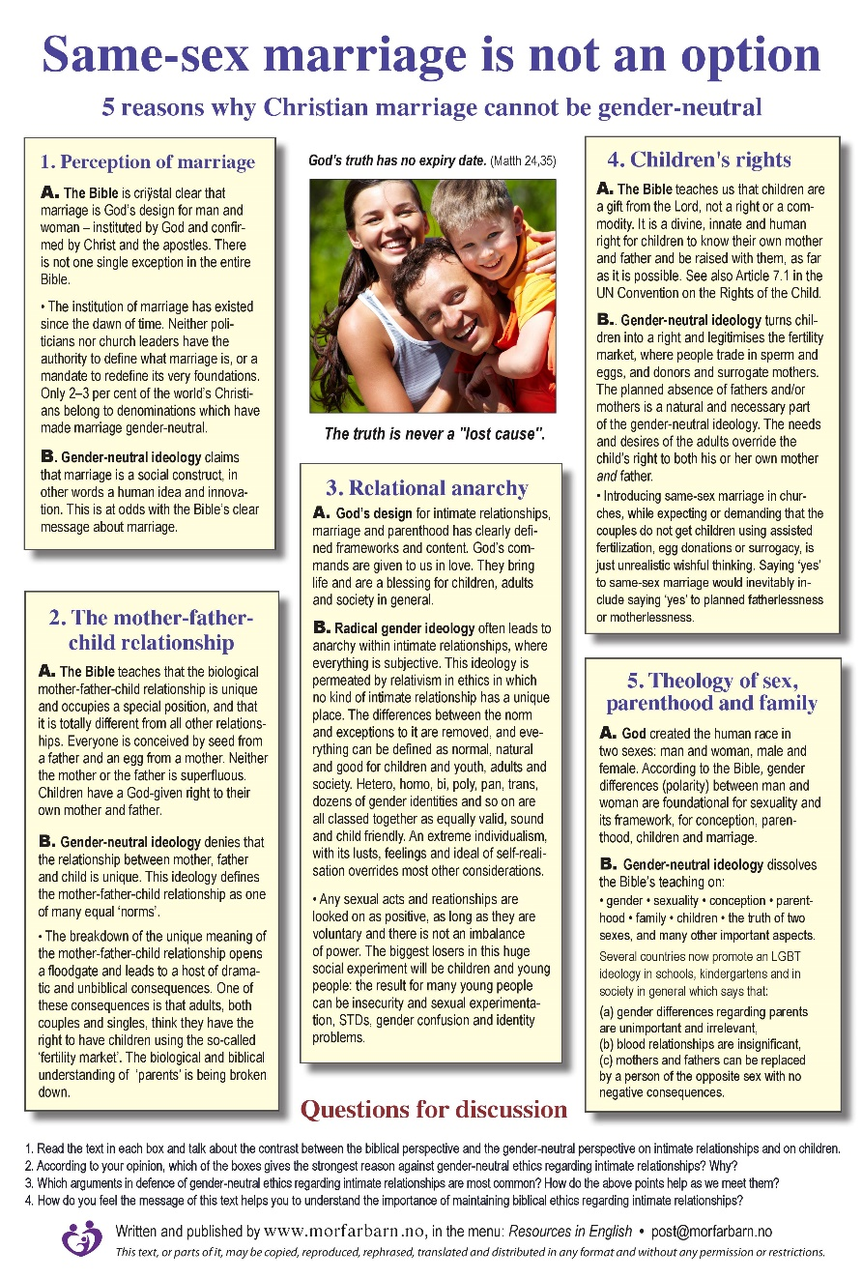
Download this resource sheet and use the text (or parts of it) in any format you like:
https://morfarbarn.no/file/same-sex-marriage-is-not-an-option.pdf

Slide 38
Go to the website and find different versions of the logo + interesting information.

Slide 39
Go to the website and find different versions of the logo + interesting information.

Slide 40
1 Corinthians 16:13–14 (NIV)
Be on your guard,
stand firm in the faith,
be courageous, be strong.
Do everything in love.

Slide 41
Ephesians 4:14–15
We will no longer be infants,
tossed back and forth by the waves,
and blown here and there
by every wind of teaching
and by the cunning and craftiness of people
in their deceitful scheming.
Instead, speaking the truth in love,
we will grow to become in every respect
the mature body of him who is the head,
that is, Christ.

Slide 42
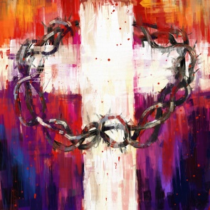
Jesus’ challenge: Radical and surprising love In Luke 6:27 Jesus says:
‘Love your enemies,
do good to those who hate you,
bless those who curse you,
pray for those who mistreat you.’

Slide 43
1 Corinthians 4:12
When reviled, we bless;
when persecuted, we endure;
when slandered, we speak kindly.

Slide 44
God has not given us
a spirit of
fear and timidity,
but of
power,
love, and
self-discipline.
2 Timothy 1:7 (NLT)

Slide 45
Ephesians 6:10–12 (NLT)
¹⁰ A final word:
Be strong in the Lord and in his mighty power.
¹¹ Put on all of God’s armor so that you will be able to stand firm against all strategies of the devil.
¹² For we are not fighting against
flesh-and-blood enemies, but against
evil rulers and authorities of the unseen world, against mighty powers in this dark world,
and against evil spirits in the heavenly places.

Slide 46
Ephesians 6:14–17 (NLT)
¹⁴ Stand your ground,
putting on the belt of truth and the body armor of God’s righteousness.
¹⁵ For shoes, put on the peace that comes from the Good News so that you will be fully prepared.
¹⁶ In addition to all of these, hold up the shield
of faith to stop the fiery arrows of the devil.
¹⁷ Put on salvation as your helmet,
and take the sword of the Spirit,
which is the word of God.

Slide 47
2 Corinthians 11:2–3 (NLT)
I promised you as a pure bride to
one husband—Christ.
But I fear that somehow
your pure and undivided devotion
to Christ will be corrupted,
just as Eve was deceived
by the cunning ways of the serpent.
Continues on next slide …

Slide 48
2 Corinthians 11:4 (NLT)
You happily put up with whatever
anyone tells you, even if they preach
a different Jesus
than the one we preach, or
a different kind of Spirit
than the one you received, or
a different kind of gospel
than the one you believed.

Slide 49
1 Corinthians 1:26–28 (NLT)
²⁶ Remember, dear brothers and sisters,
that few of you were wise in the world’s eyes
or powerful or wealthy when God called you.
²⁷ Instead, God chose things the world considers foolish in order to shame those who think
they are wise. And he chose things that are powerless to shame those who are powerful.
²⁸ God chose things despised by the world,
things counted as nothing at all,
and used them to bring to nothing
what the world considers important.

Slide 50
Deuteronomy 13:4
The Lord your God you shall follow,
him alone you shall fear,
his commandments you shall keep,
his voice you shall obey,
him you shall serve,
and to him you shall hold fast.

